Slide 1


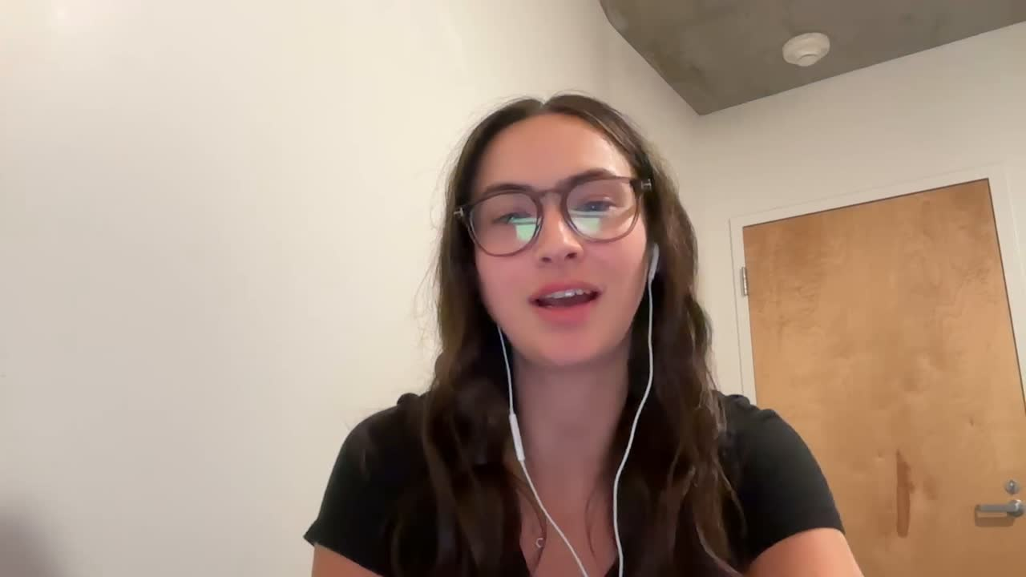
Milestone 1
Business Process Analysis - How Generative AI Can Enhance Productivity in the Music Industry
Eleanor Amidei, Carolina Reta, and Erin Yabsley

Slide 2


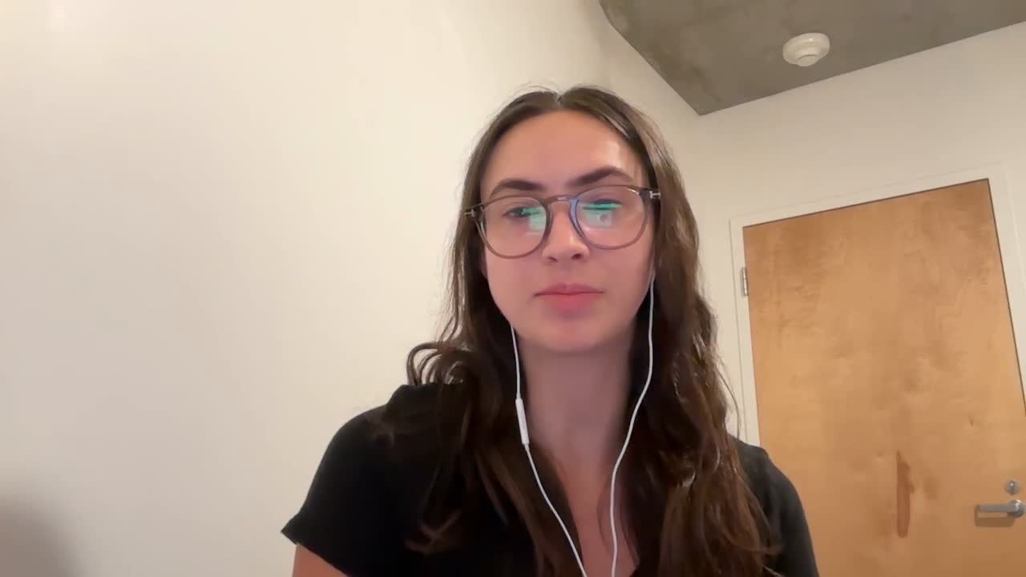
Red Light Management
About us
Red Light Management is one of the world’s leading artist management companies, representing a diverse roster of top-tier talent across music genres.
Red Light provides personalized, full-service management that empowers artists to grow their careers creatively and commercially on a global scale.

Slide 3
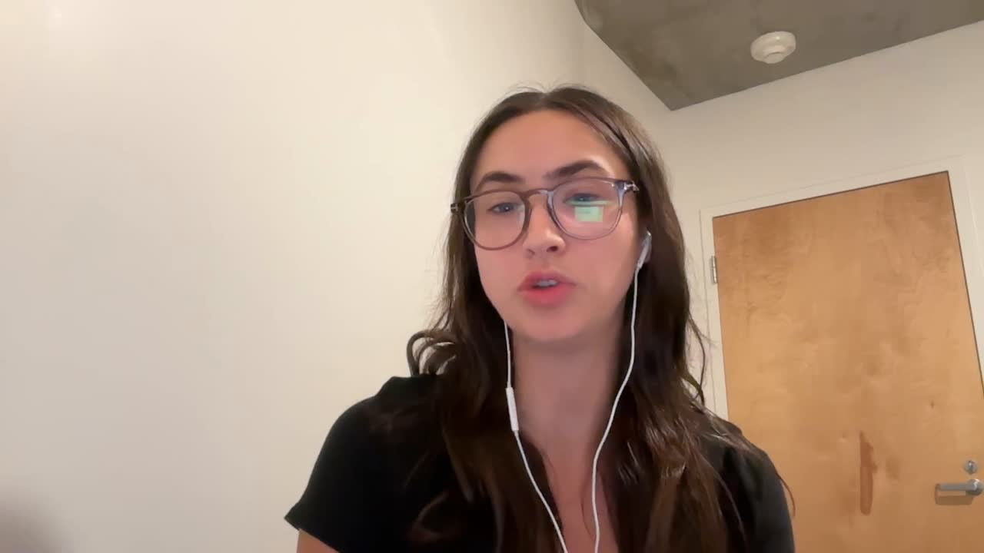

Red Light Management
Business Process
We analyzed the full lifecycle of a music artist’s planning and execution of a tour after a music release. We generated the business process flowchart by completing industry research, watching ‘a day in the life’ content created by artist managers, and by conducting interviews with individuals responsible for planning and booking artists for festivals.

Slide 4
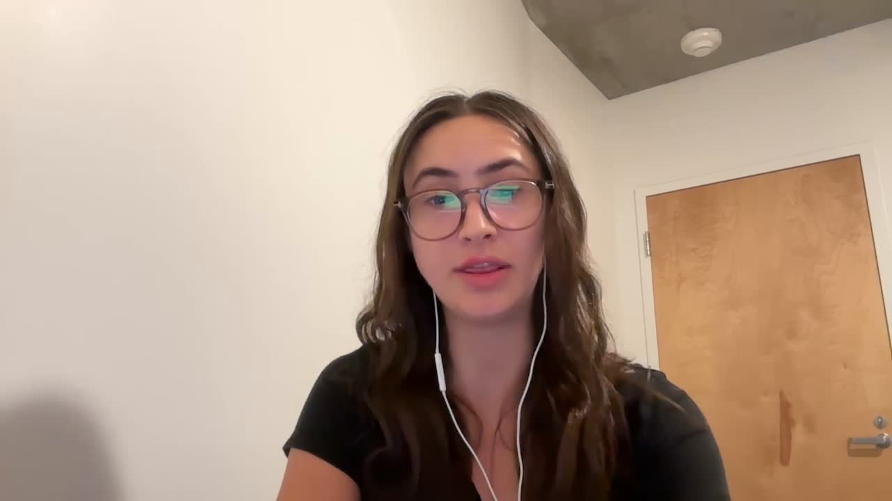
Red Light Management
Process Overview
Tour Planning & Opportunity Evaluation
Negotiation & Offer Review
Contract Finalization
Logistics Planning
Promotion & Marketing

Slide 5
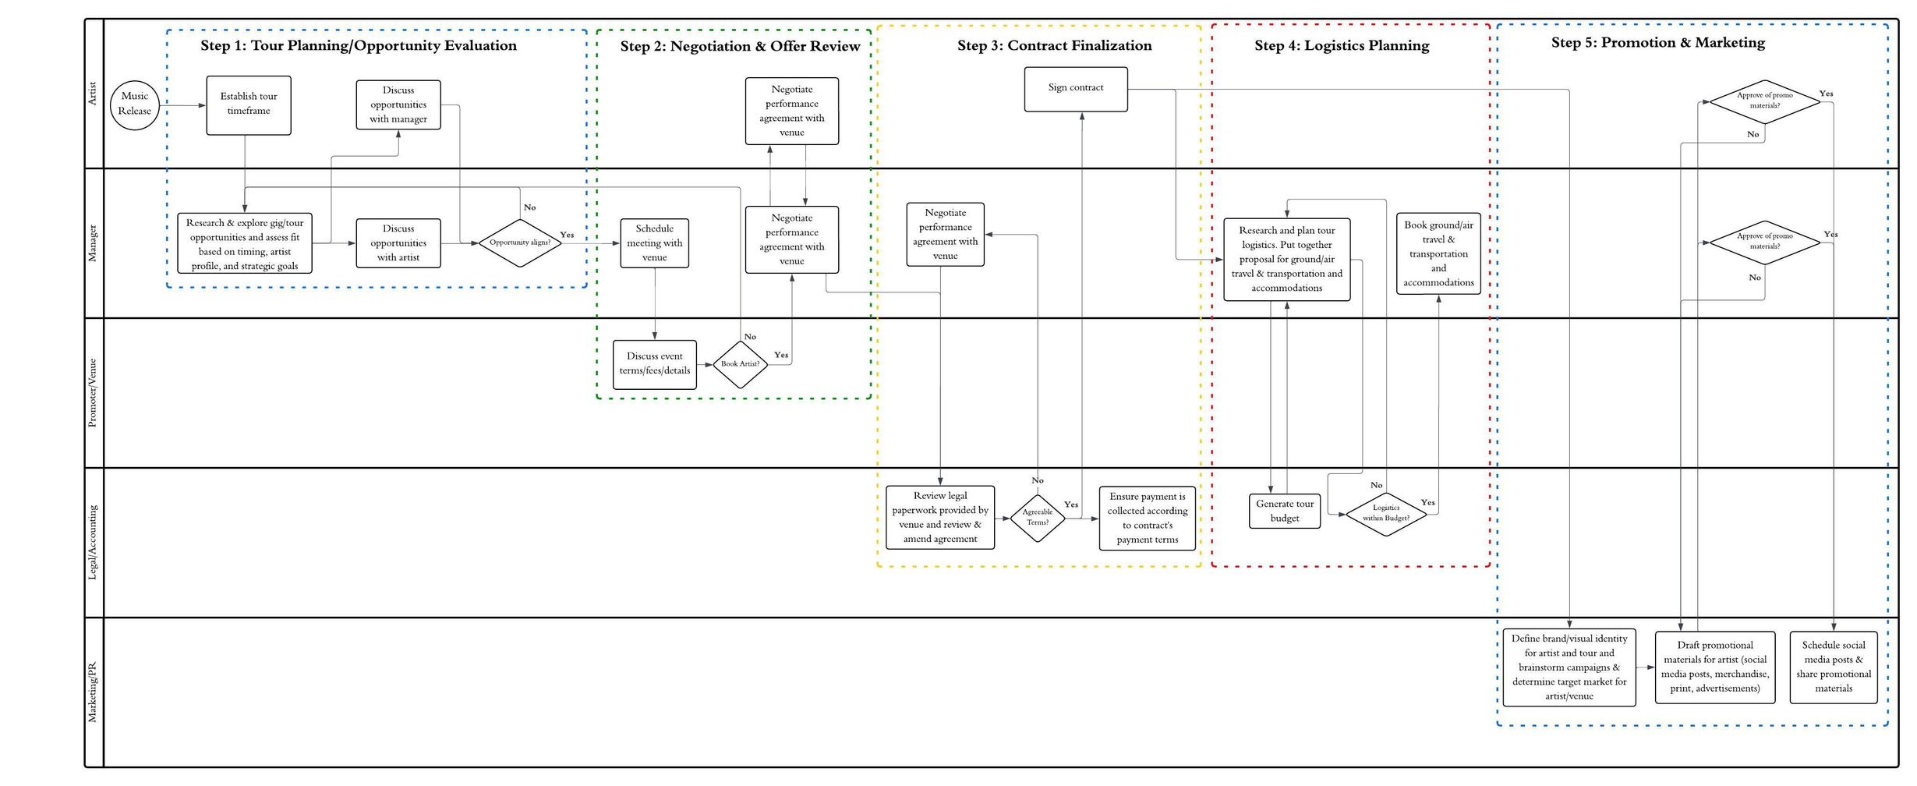
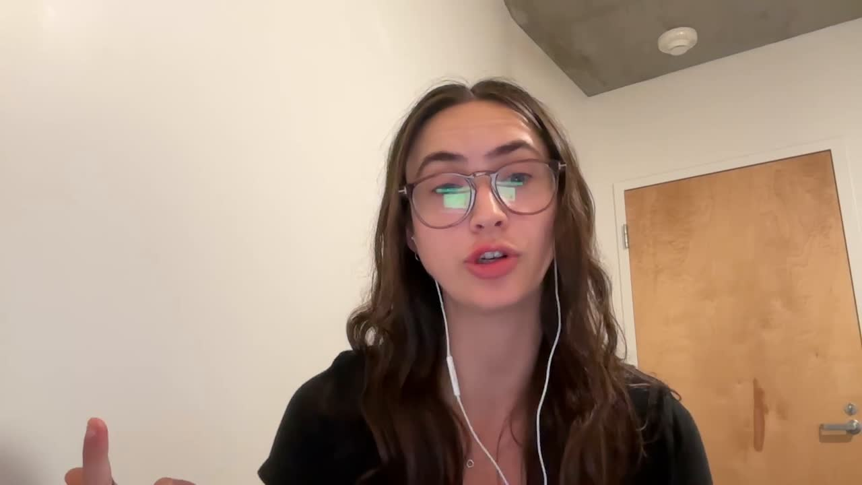
Red Light Management

Slide 6
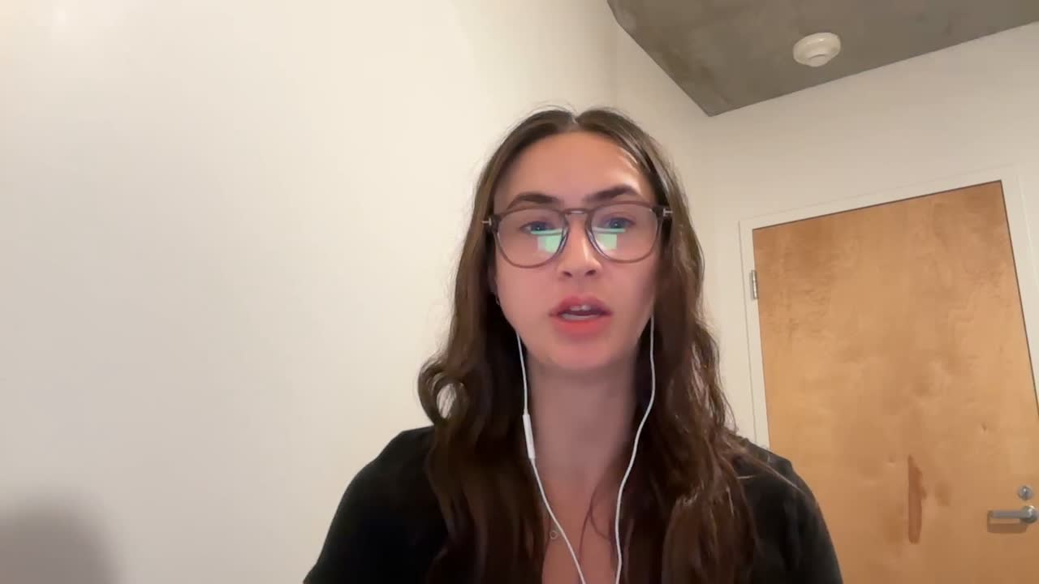
Red Light Management
01
02
Pain Points & Inefficiencies
Data Overload
Contract Delays & Errors
Discovering opportunities that match an artist’s brand and aligning the availability of an artist with the venue
Promoters for a venue can takes days to coordinate meetings to discuss contract details and contracts are often missing details or required forms
03
04
Disjointed Logistics
Incorrect Forecasts
Bad tour routing requires last minute, reactive planning leading to unnecessary spend and inefficient resource allocation
Agents are unable to provide accurate forecasts to the venue of how many attendees the artist will draw leading to ineffective ticket pricing strategies

Slide 7


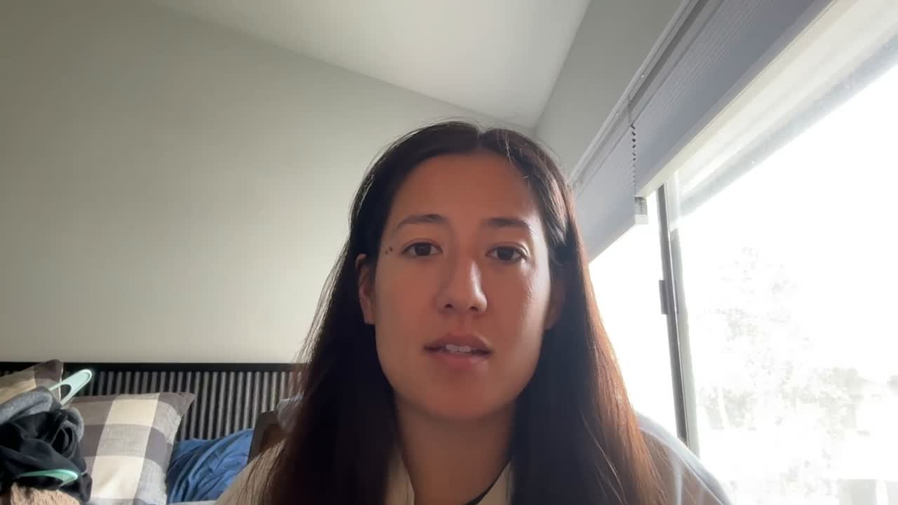
Red Light Management
Integration of GenAI

Slide 8
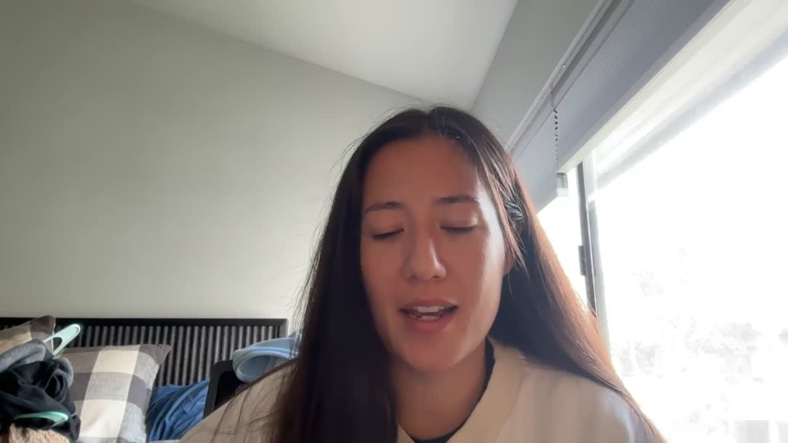
Red Light Management
We re-imagine the lifecycle of music tour planning and execution with the integration of generative AI.

Slide 9
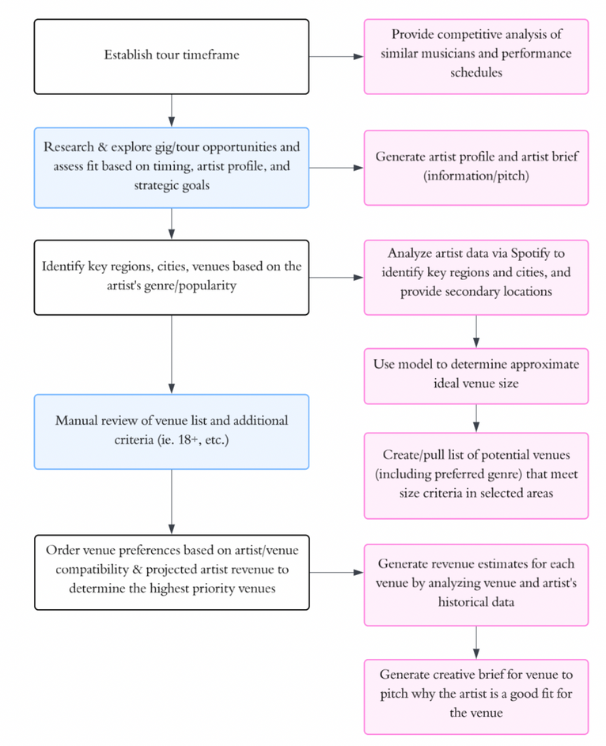
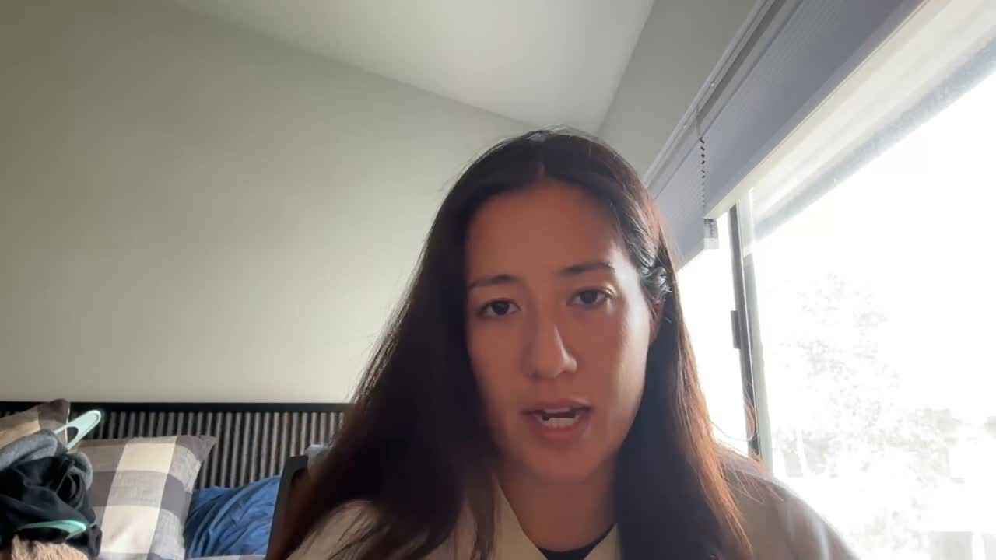
Red Light Management
Legend
Suggested use of GenAI
Human Touchpoint
1. Tour Planning & Opportunity Evaluation

Slide 10
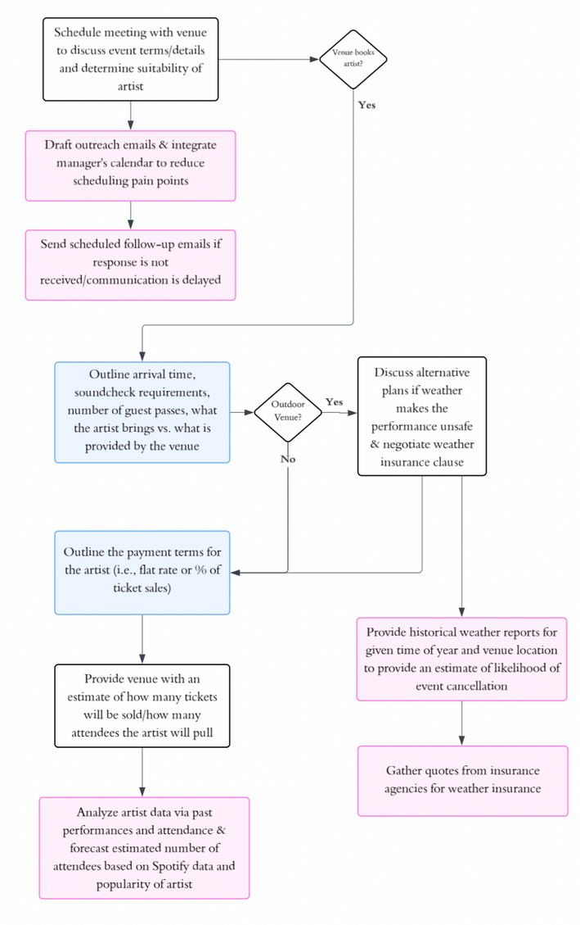
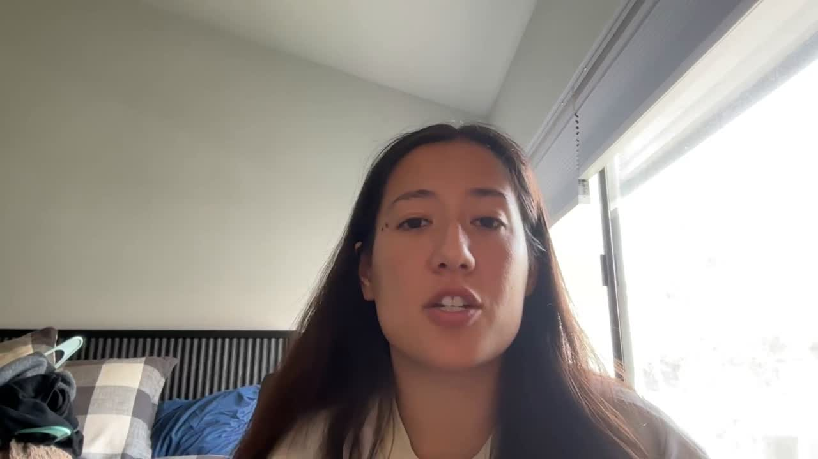
Red Light Management
Legend
Suggested use of GenAI
Human Touchpoint
2. Negotiation & Offer Review

Slide 11
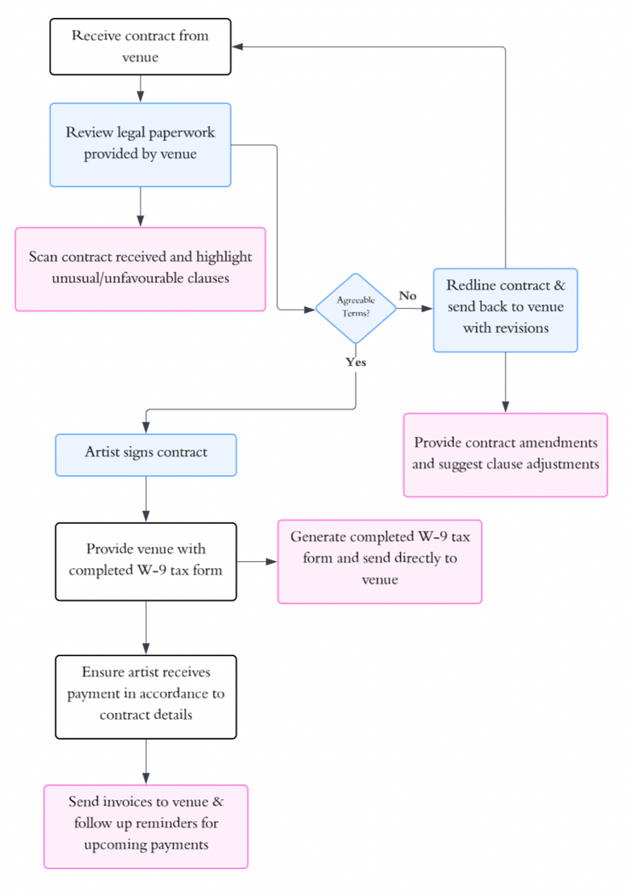

Red Light Management
Legend
Suggested use of GenAI
Human Touchpoint
3. Contract Finalization

Slide 12
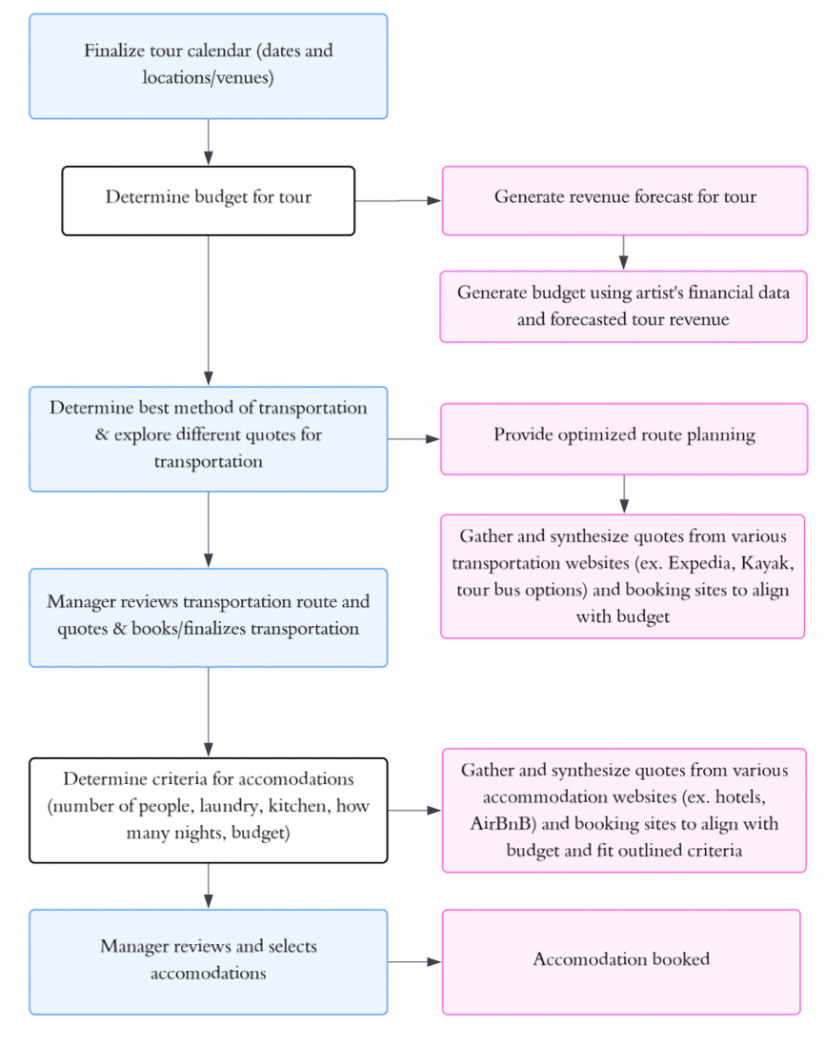
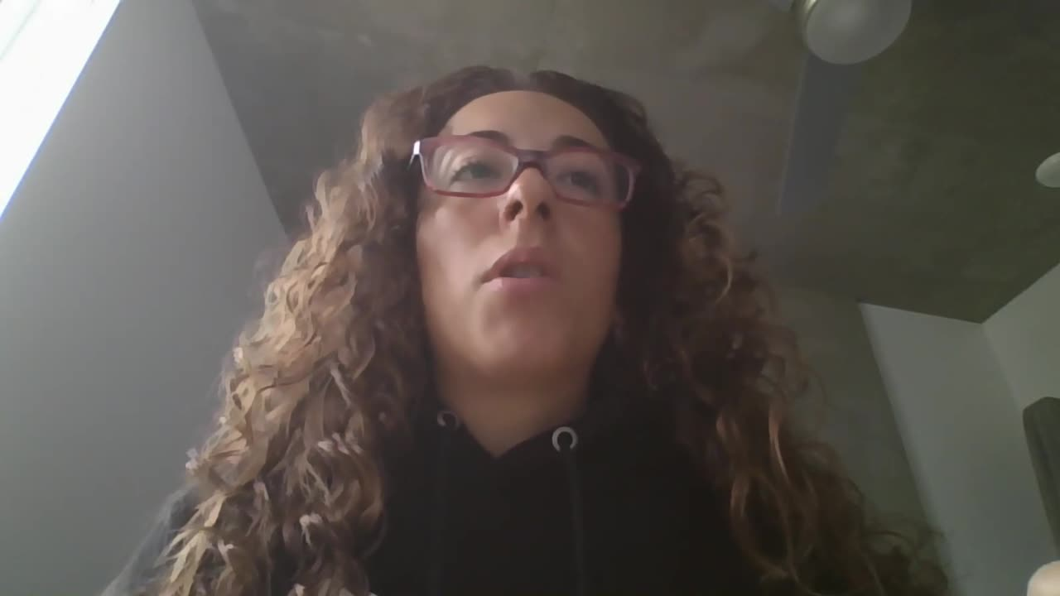
Red Light Management
Legend
Suggested use of GenAI
Human Touchpoint
4. Logistics Planning
Notes:
Logistics is time-consuming and error-prone.
Our AI cuts planning time by generating budgets, optimizing tour routes, and sourcing the best travel and accommodation options.
Managers focus on approvals, not manual booking. The result? Faster decisions.

Slide 13
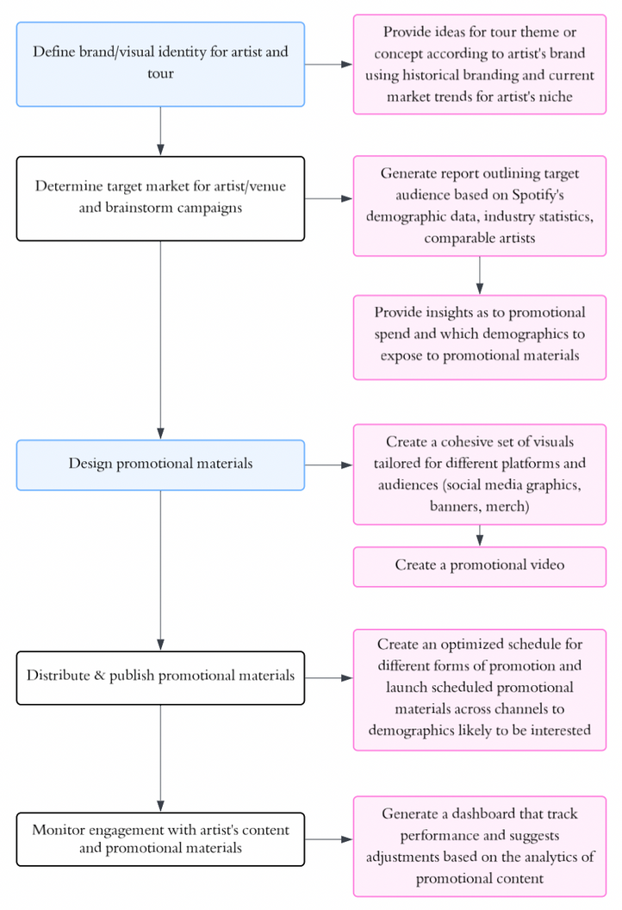
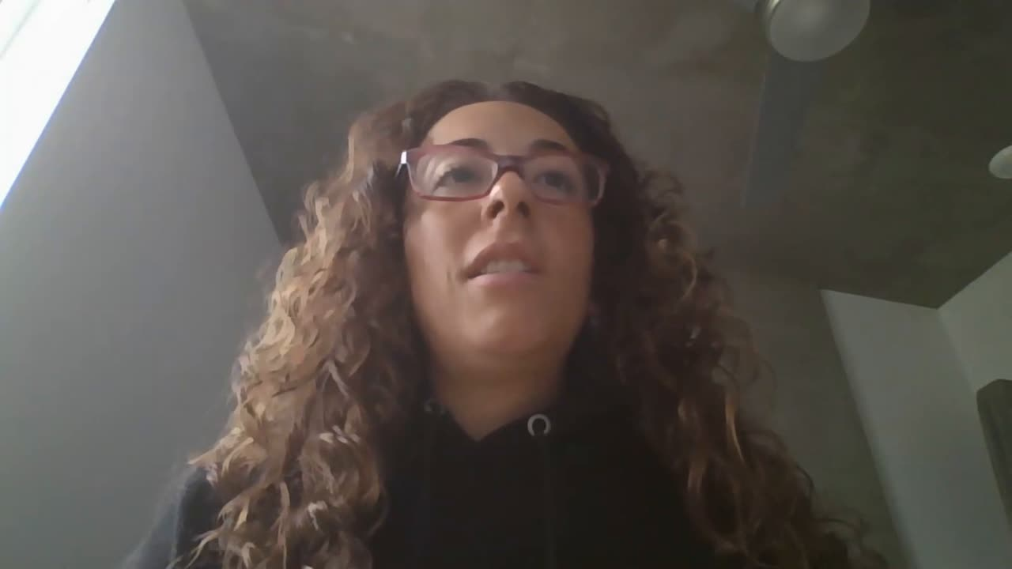
Red Light Management
Legend
Suggested use of GenAI
Human Touchpoint
5. Promotion & Marketing
Notes:
Late or misaligned promo leads to lower ticket sales.
GenAI helps define tour branding, generate targeted visuals, and schedule content tailored to the artist’s audience.
Teams stay in control creatively, but AI ensures early, smart, and effective promotion.

Slide 14




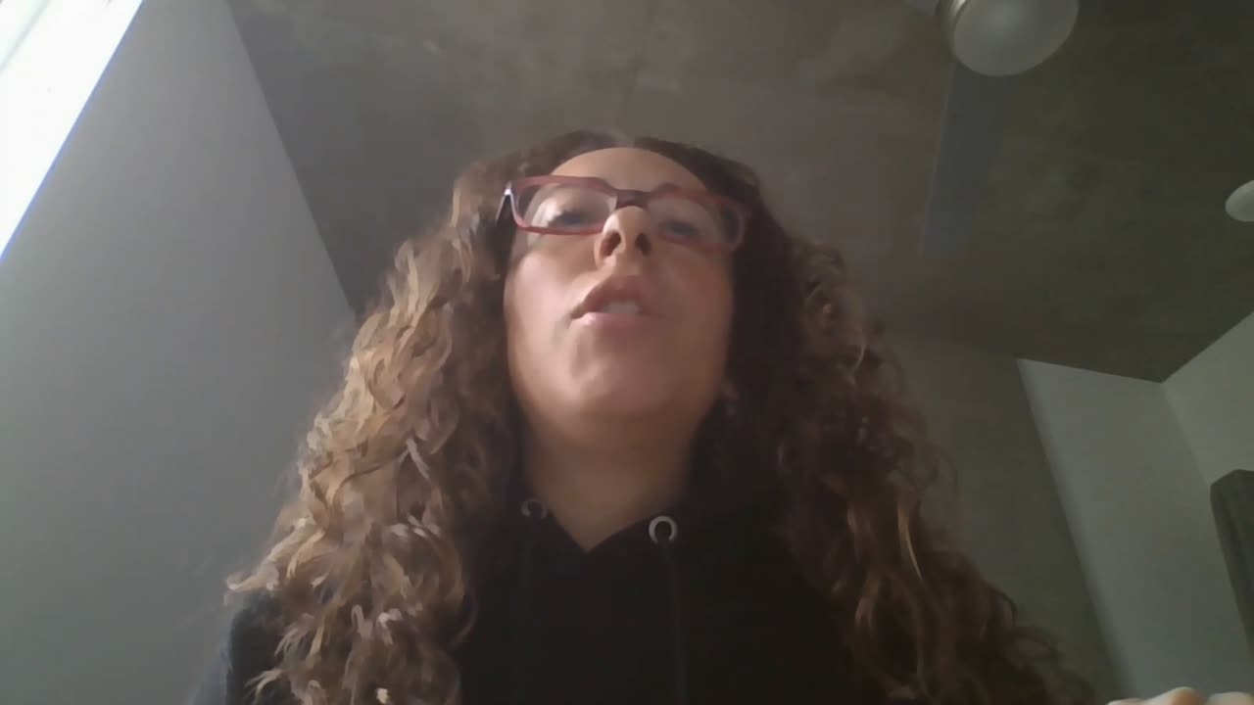
Red Light Management
Expected Business Impact
Reducing Delays in Negotiation
Boosting Tickets Sales
Up to $3,000
Up to $15,000
Based on our research, we quantify the impact that AI will have in term of time savings and the resulting cost savings.
GenAI solution could achieve near $20,000 annually per artist.
Lowering Logistics Changes
Cutting Contract Errors
Up to $4,800
Up to $420
Notes:
With this approach, we reduce delays, prevent errors, and improve marketing impact.
Estimated ROI: Up to $20K in value per artist per year—through time saved, better routing, and stronger sales.

Slide 15

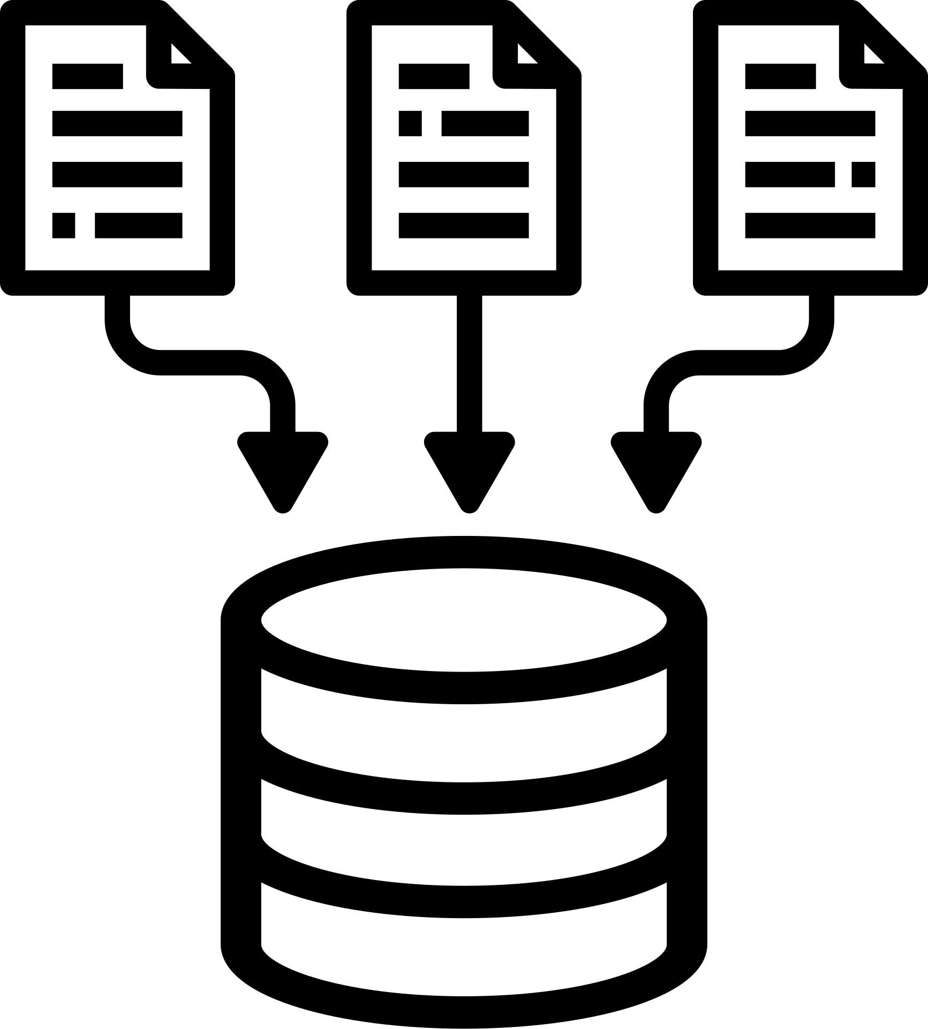


Red Light Management
Technical Implementation Approach
Our platform integrates GenAI to streamline artist tour planning, negotiation, logistics, and promotion by combining a modular architecture with API integrations and AI models.
When an opportunity is identified the system:
Pulls streaming metrics
Recommends venues
Estimates audience draw
Drafts personalized pitches
Review contracts
Auto-generates and launches the promotion
Web Platform
Backend & Data Layer (APIs)
Cloud Services
Notes:
From a technical standpoint, our solution would operate through a web platform backed by secure cloud services.
We use APIs to pull data from Spotify, Expedia, and social media platforms. GenAI models generate forecasts, outreach, visuals, and contract suggestions.
When an opportunity arises, the system analyzes fan data, suggests venues, drafts materials, and launches marketing—all under manager supervision.
It’s modular, scalable, and built to empower human creativity

Slide 16



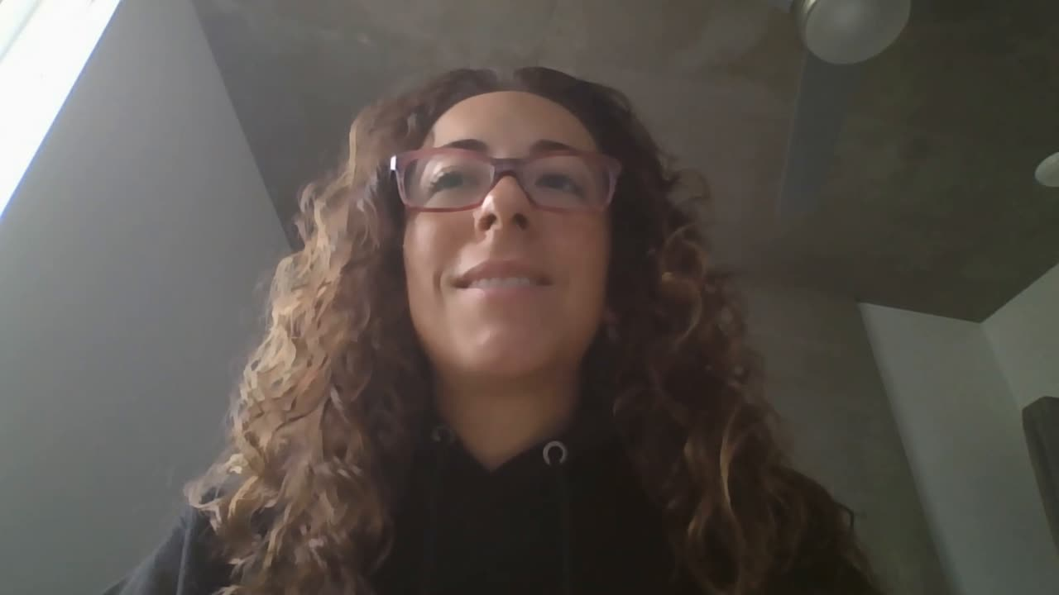
Red Light Management
Our Team
Eleanor Amidei
Carolina Reta
Erin Yabsley

